Slide 1
Welcome to multimedia class

Slide 2
Identity
Jesmin Islam
Lecturer in English
Rayenda Rajoir Fazil Madrasha
Sharankhola , Bagerhat.
E-mail : jesminislam84bd@gmail.com
Mobile no: 01791157285
English For Today
Classes : XI-XII

Slide 3
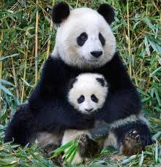
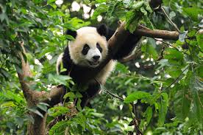
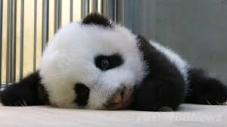
Let us see some pictures.

Slide 4
Let’s enjoy a video .

Slide 5
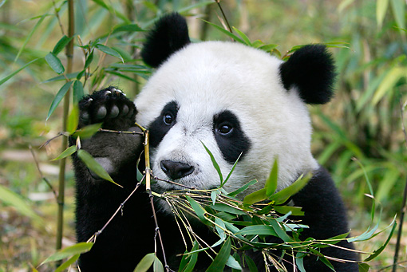
Our today’s lesson is -
The Giant Panda
Unit : Eight ( Environment and Nature ) , Lesson : 3

Slide 6
Learning Outcomes
At the end of the lesson students will be able to -
tell about Pandas life style .
describe what should be done to continue bamboo production .
describe harmful effect of high temperature on the bamboo production .

Slide 7
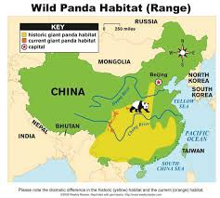
Let us know about Panda.
Pandas native habitats are in China .

Slide 8
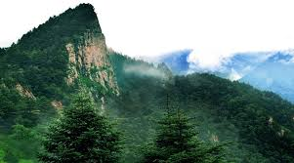
Qinling Mountain region of China .
Most of the Pandas live in the Qinling Mountain region of China.

Slide 9
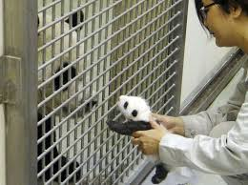
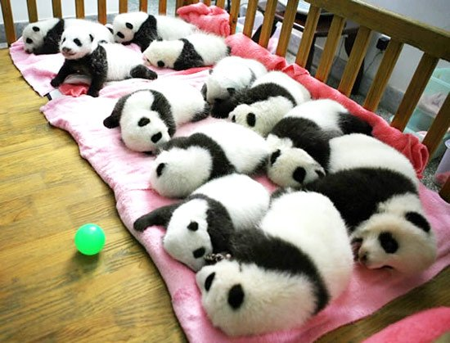
Zoo
Breeding center
Pandas live around the world in zoos and breeding centers .

Slide 10
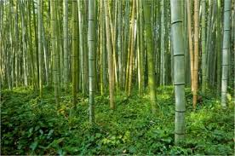
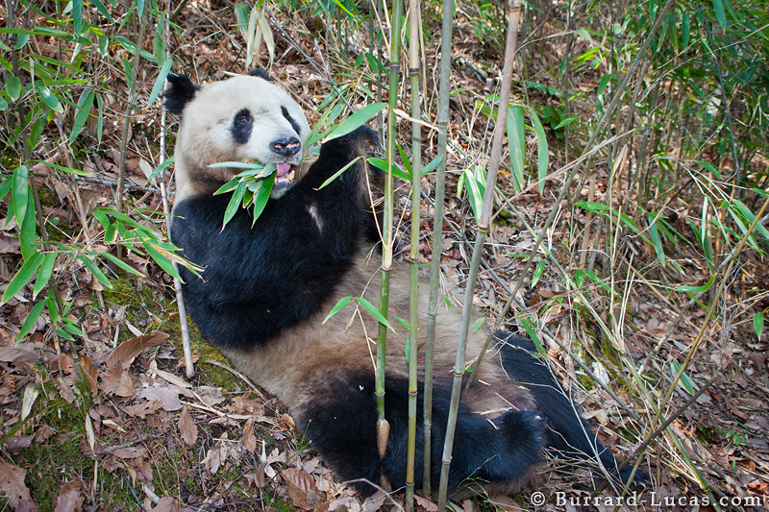
Bamboo is the only source of food for Panda .
Ninety –nine percent of a panda’s diet is bamboo.

Slide 11
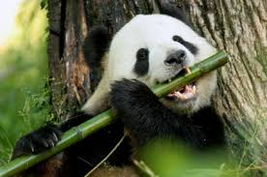
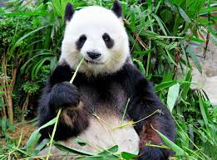
Pandas need bamboo to exist .
An adult Panda needs around 38 kilograms of bamboo everyday.

Slide 12
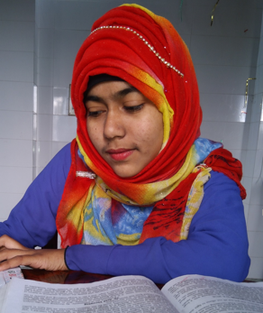
Individual work
Where do the Pandas live in addition to their native habitats?

Slide 13
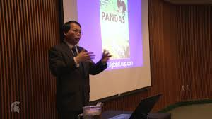
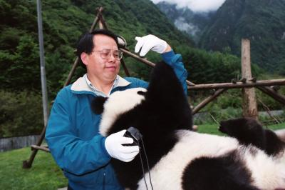
What is the future prediction of Jianguo Liu about Pandas ?
Jianguo Liu doesn’t predict bright future for the Pandas of China because Pandas are losing their wild habitats .

Slide 14
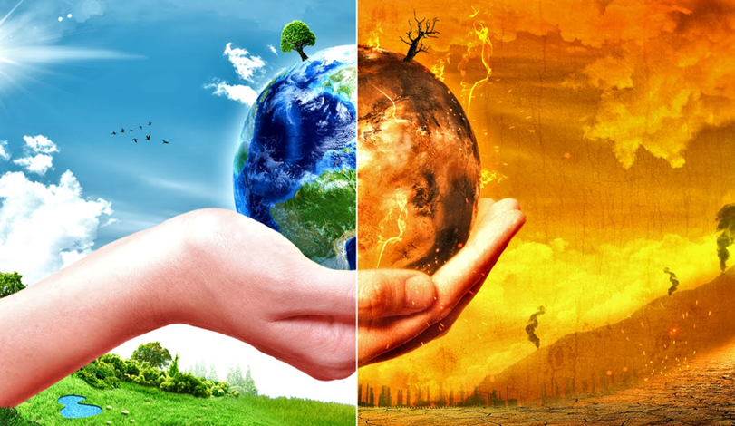
How are Pandas losing their wild habitats ?
Climate change
Pandas are losing their wild habitats because of climate change .

Slide 15
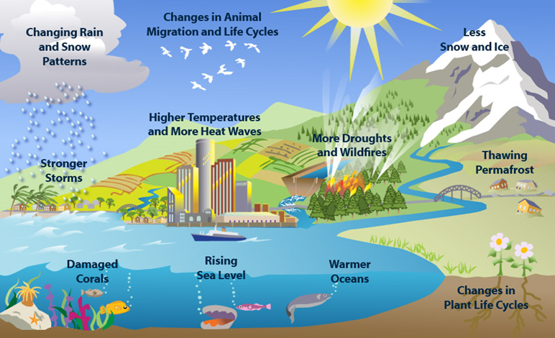
What is climate change ?
Climate change is a change in the statistical distribution of weather patterns when that change lasts for an extended period of time .

Slide 16
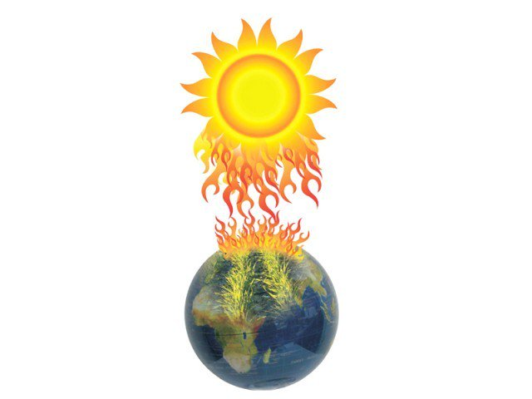
What is the result of climate change ?
Sun
Earth
Because of climate change , the world temperature is on constant rise .

Slide 17
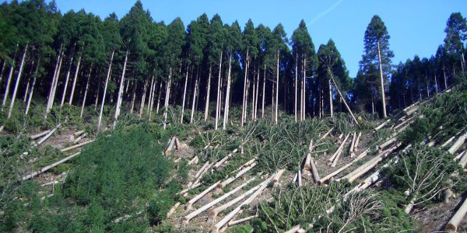
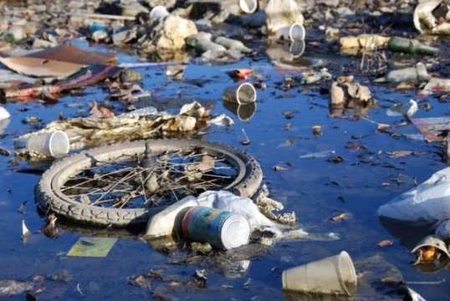
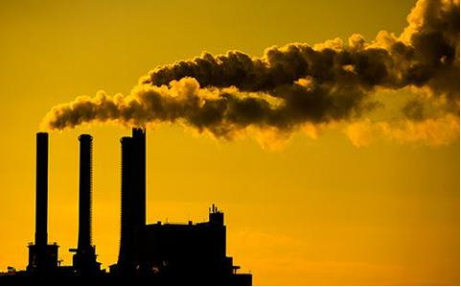
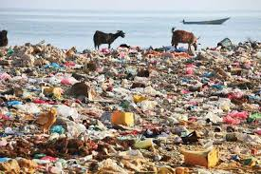
What are the causes of climate change ?
Deforestation
Water pollution
Deforestation, water pollution, air pollution, soil pollution etc are responsible for climate change .
Air pollution
Soil pollution

Slide 18
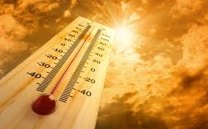
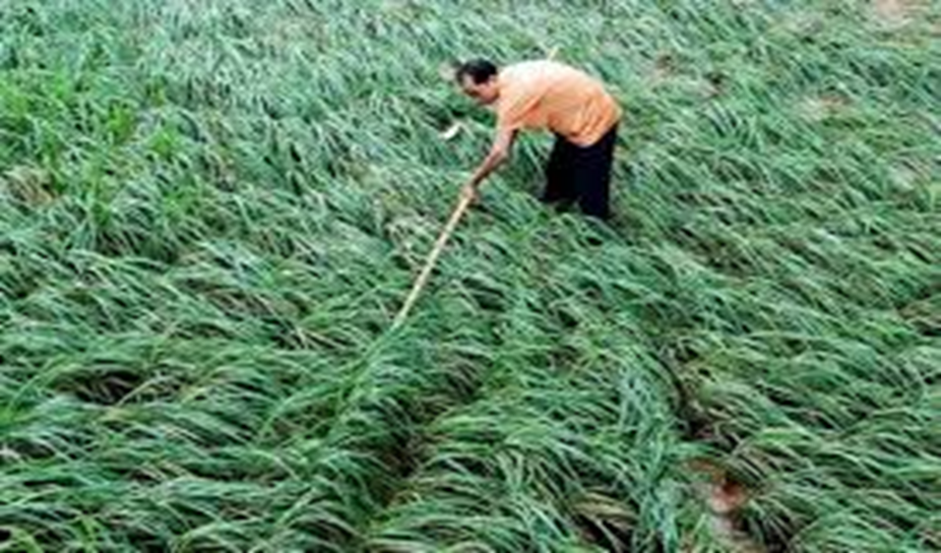
How does global warming affect Pandas ?
Hot temperature
Cool temperature
Global warming affects pandas bamboo food because bamboo can not grow well in increased temperature . Bamboo need cool and pollution free areas.

Slide 19
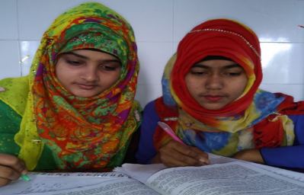
Pair work
1
Bamboo is the sole source of food for endangered pandas .
2
3
4
5
6

Slide 20
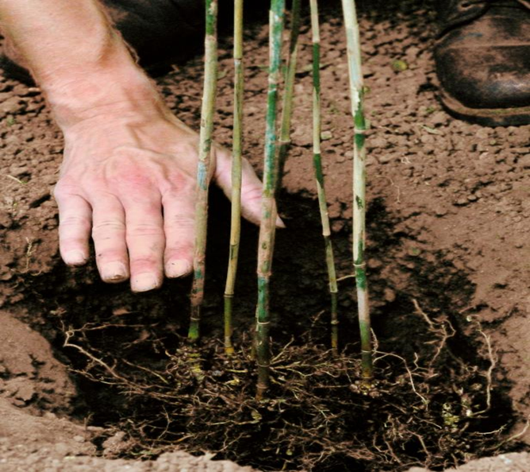
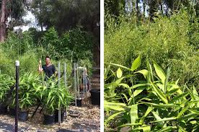
What steps should we take to protect bamboo ?
We need to shift the bamboo habitats to a cooler and pollution free place from present location if we want to save them and thereby save the pandas.

Slide 21
Group A
Group B
How does climate change affect the existence of Pandas ?
What should we do to protect our Pandas?

Slide 22
Home work
Write a paragraph on “ The Giant Panda” .

